Slide 1
Describing Graphs, Tables and Charts

Slide 2
What is a chart?
A chart is a diagram that makes information easier to understand by showing how two or more sets of data are related.
There are four common types of chart.

Slide 3
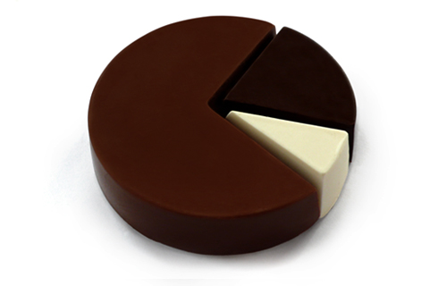
Pie Chart（饼图)
这种图表多数用来表示各种事物在总数百分之一百种所占的各自比例。

Slide 4
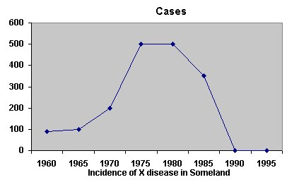
Line Graph（线图）
这种曲线图用来表示一种事物的上升趋势或下降趋势。

Slide 5
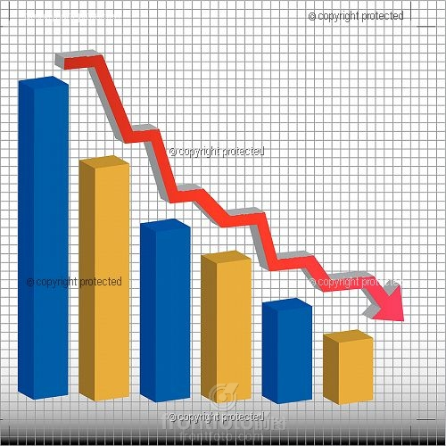
Bar Graph（条形棒图)
一般用来比较几种事物在同一时期上升或者下降的情况。

Slide 6
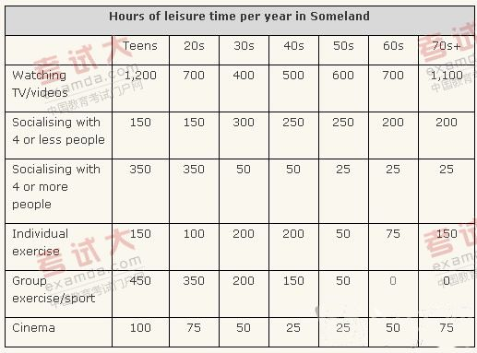
Table（表格图）
这种图表用于表示多种事物间的相互关系。

Slide 7

Describing Trends in Graphs

Slide 8
What is a trend?
Trends are the changes or movements in facts and figures over a period of time.
We can use different verbs and nouns to describe trends

Slide 11
迅速增长地，迅猛发展地

Slide 12
Downward movement (verbs)
decline decrease drop fall slide
lose ground
crash collapse plummet plunge
take a fall
weaken

Slide 13
Upward movement (verbs)
climb rise increase
grow
surge
rocket
soar gain
go through the roof
jump
rally （回升）
strengthen

Slide 14
Stability (verbs)
flatten out hold steady level off stabilise
bounce back rally recover

Slide 15
For specifying the degree of change we can use different adjectives
Slow
Steady
Slight
Sharp
Gradual
Disastrous
Massive
Perilous（危险的）
Rapid
Heavy
Nervous

Slide 16
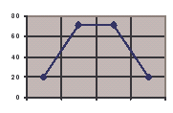
1
Production started climbing steadily but flattened off at a level of around 70. Since then, it has fallen steadily.

Slide 17
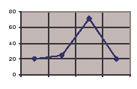
2
Production grew more and more rapidly over the first three quarters but then reached a peak. Since then, it has quickly dropped.

Slide 18
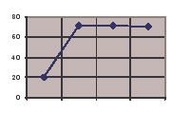
3
Production grew rapidly in the first quarter, but reached a plateau of about 70. Since then it has remained more or less stable.

Slide 19
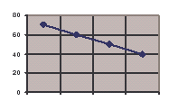
4
Production has dropped slowly but steadily over the year.

Slide 20
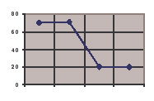
5
Production started the year in a stable position, but then plunged in the third quarter. It has now flattened out at a level of 20.

Slide 21
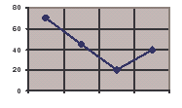
6
Production fell considerably over the first three quarters, reaching a low of 20. Since then it has staged a partial recovery.

Slide 22
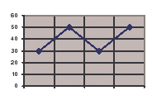
7
Production has fluctuated all year.

Slide 23
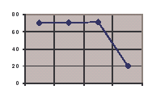
8
Production started off steady, but fell sharply in the last quarter.

Slide 24
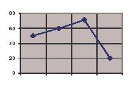
9
Production showed a marginal rise in the first three quarters, but then suffered a sharp drop.

Slide 25
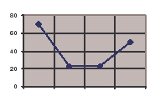
10
After a considerable drop in the first two quarters, production bottomed out at 20. Since then it has started to rise.

Slide 26
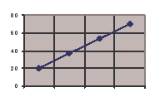
11
Production has experienced a strong, steady growth over the whole year.

Slide 27
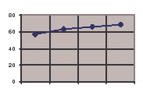
12
There has been a slight increase in production over the year.

Slide 28
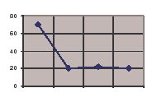
13
There was a rapid drop in production in the first quarter, but it bottomed out at about 20.

